Slide 1

SONG RECOMMENDATION SYSTEM
Capstone Project
MIT-IDSS Oct20-B – GROUP 4
Presented by : Angad Bagga
Lakshminaryanan
Sachin Sawant
Sudeep :

Slide 2


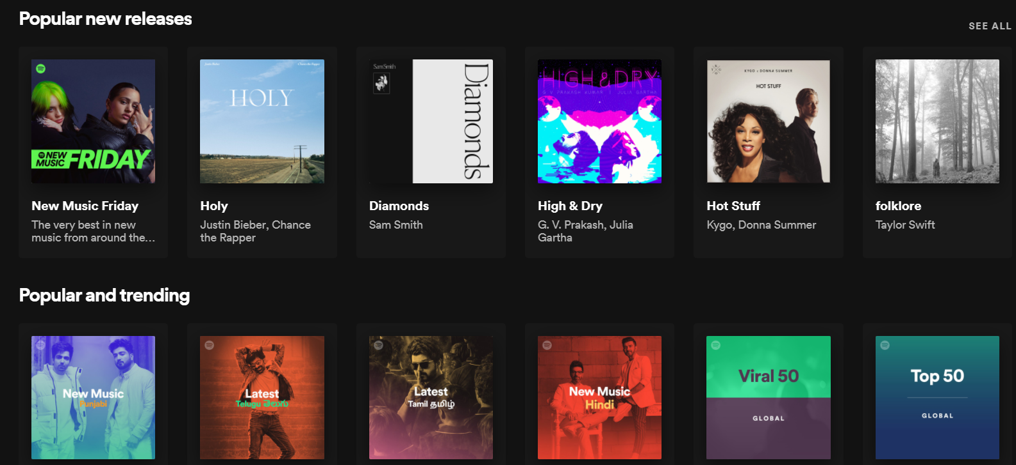
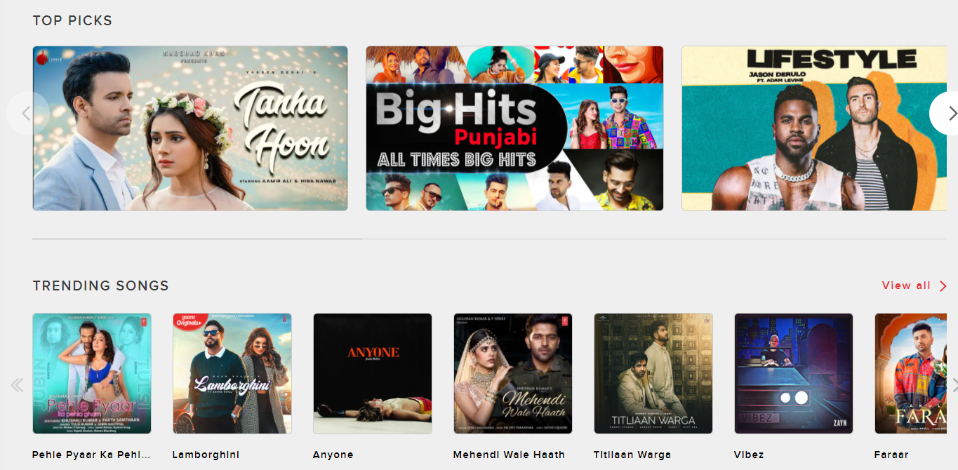
Popularity based Recommendation & Approach
How Popularity based Recommendation will help the Customer ?
It helps with the cold start problem.
No historical data needed for customer.
Customer can upfront visualize the overall popularity and is an exciting feature.
Showing popular new releases can reduce the popularity bias
Approach followed in the project to measure Popularity
1. Popularity by number of time song is played by distinct user. While searching we can search top songs with some minimum interaction
Build on top of given dataset
2. Popularity by ratings & number of votes. While searching we can search top songs with some minimum interaction
Introduced a new dataset for ratings and number of votes
Snap shot from Spotify.com
Snap shot from Gaana.com

Slide 3
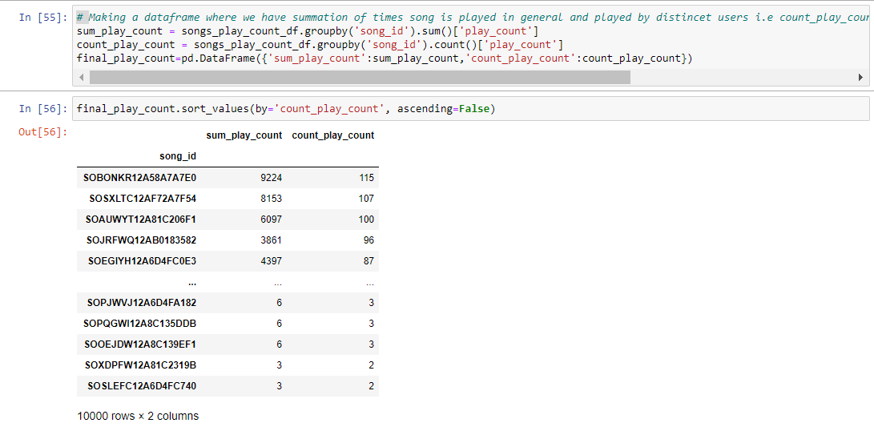
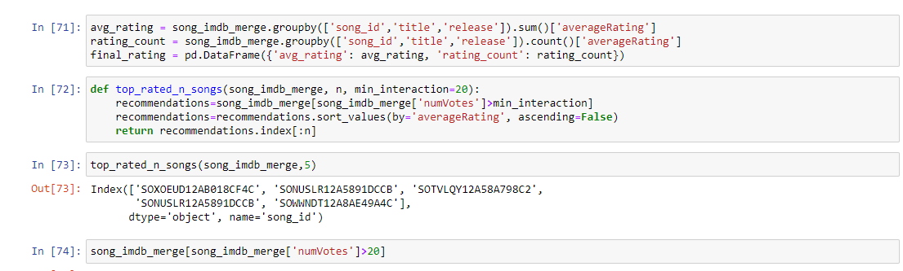
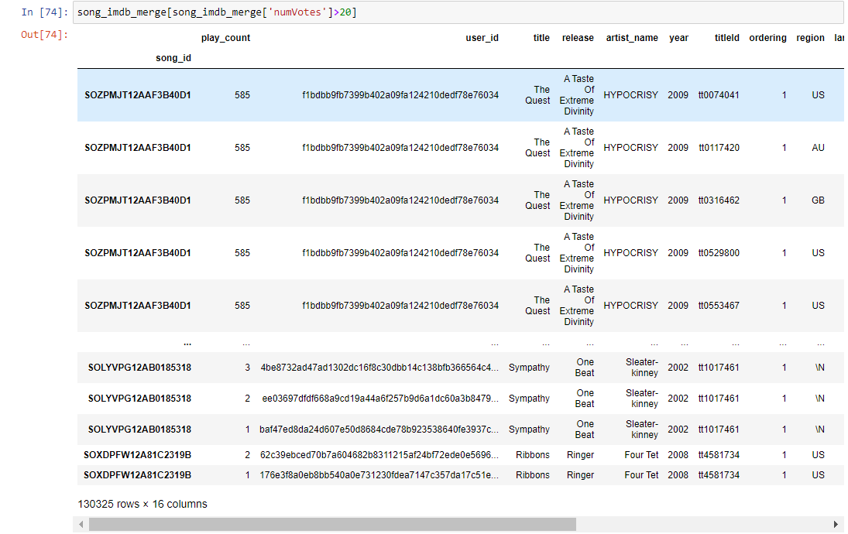
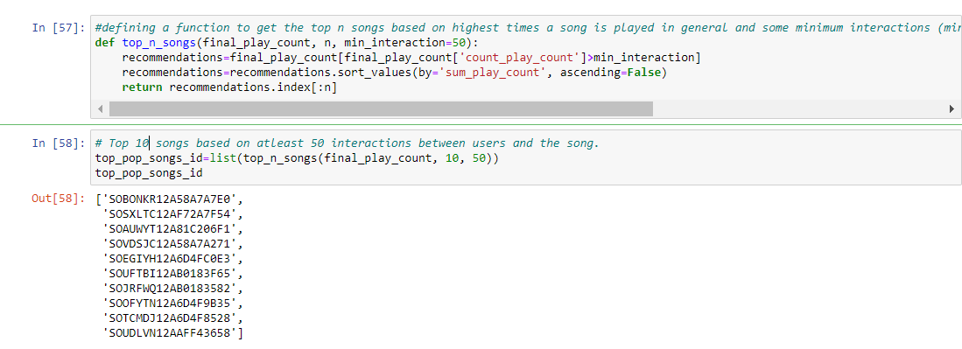
Logic - Popularity based Recommendations

Slide 4

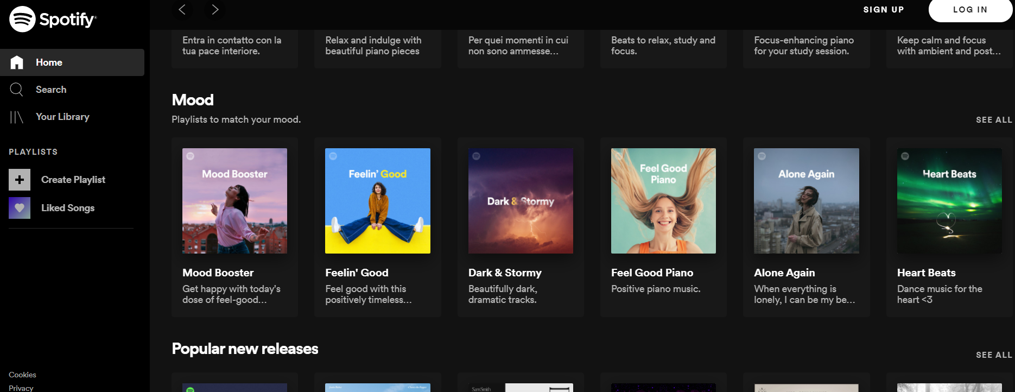
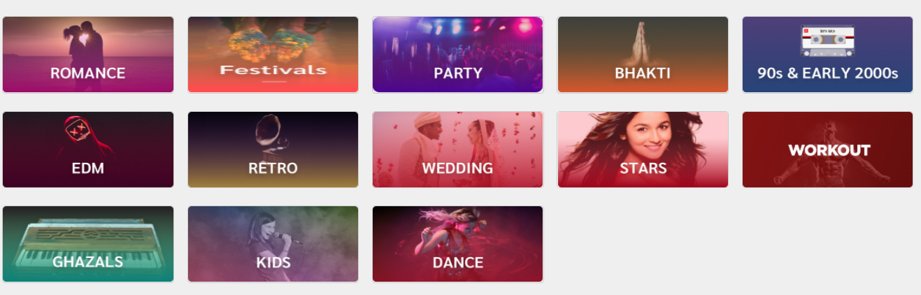
Content based Recommendations & Approach
How Content based Recommendation will help the Customer ?
Approach followed in the project for content based recommendations
Recommends similar content to the songs user has liked in the past to give personalized experience.
Doesn’t require a lot of User data
1. We are using Gensim (Generate similar) for content based recommendation as its design to handle large text collections and does not need to have everything in memory at once.
We are using combination of ‘title’, ‘artist’, ‘genre', 'release’
2. We are doing Sentiment Analysis based on the lyrics
Introduced a new dataset for lyrics.
Real examples of content based recommendation

Slide 5
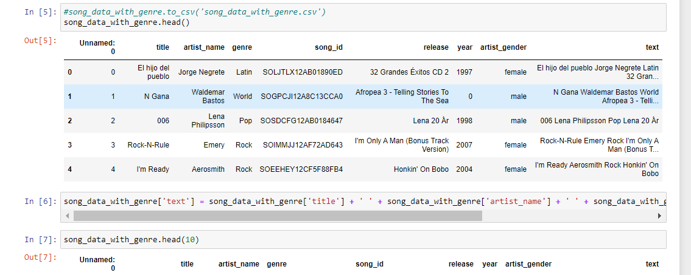
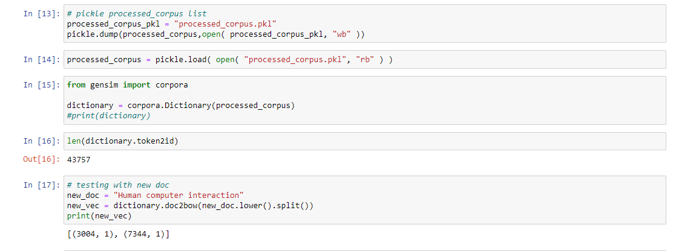
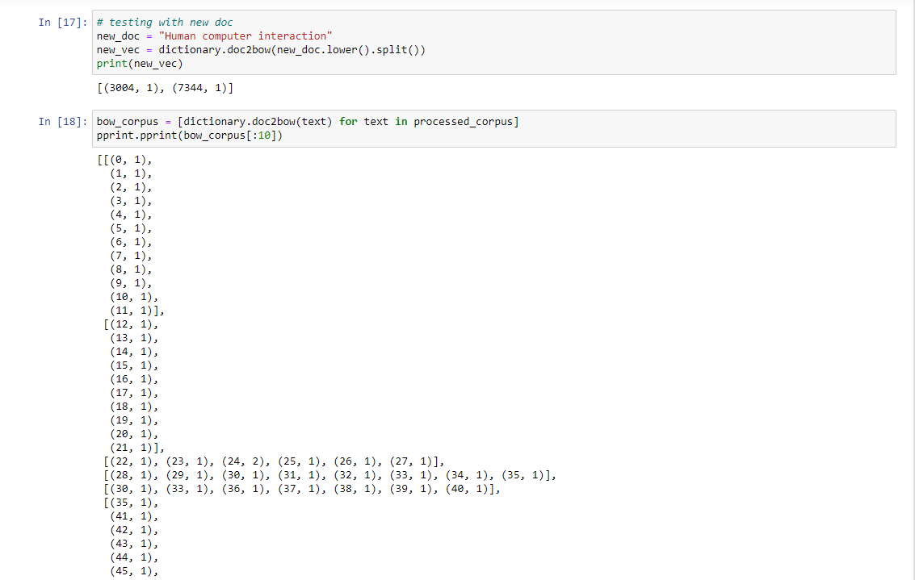
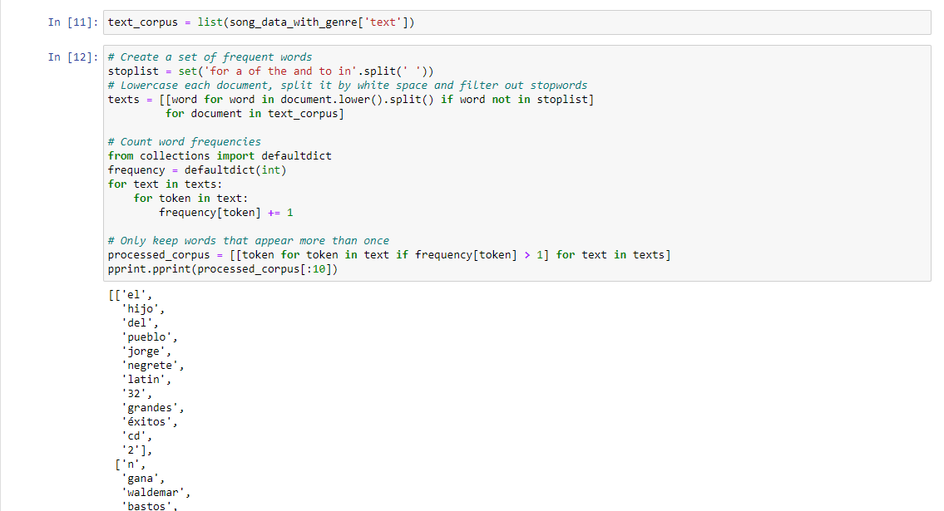
Logic – Content based Recommendation
Step 1 : Created a data frame song_data_with _Genre & a field named as text which combines ‘title’, ‘artist’, ‘genre', 'release’
Step 3 – Pickling Corpus list and creating a dictionary using corpora
Step 2 : Created a list of values in text and after counting the frequencies keeping the words/tokens that occurred more than once.
Step 4 – Testing with new doc and creating a list bow_corpus

Slide 6
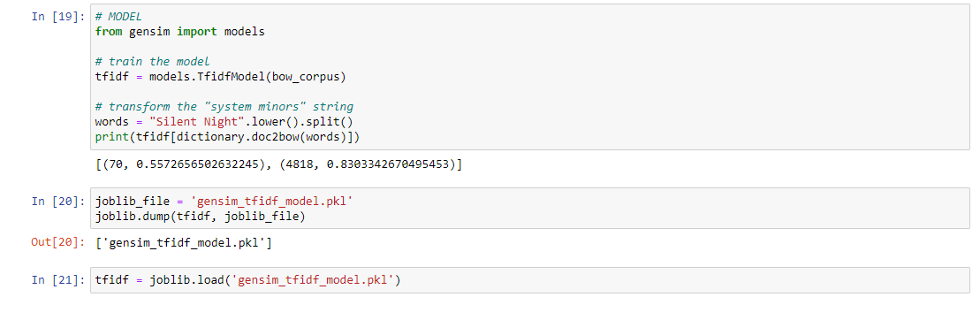
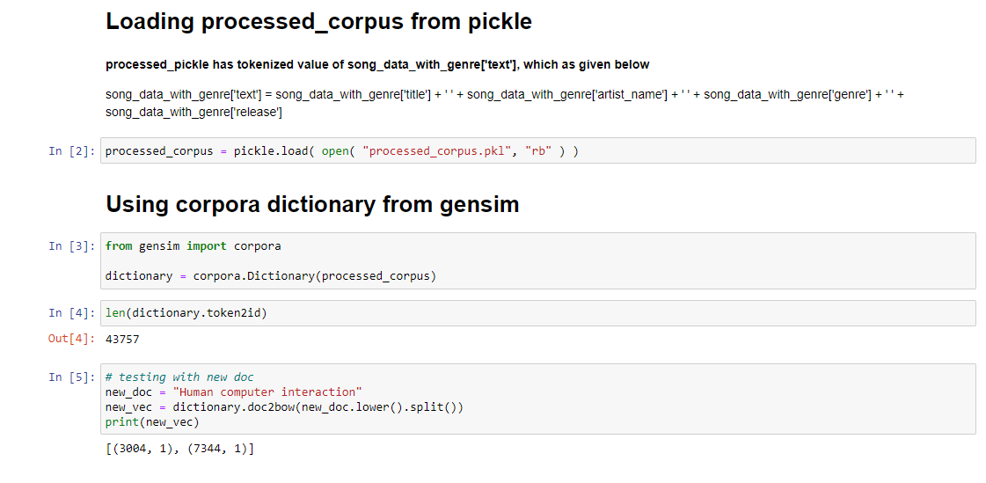
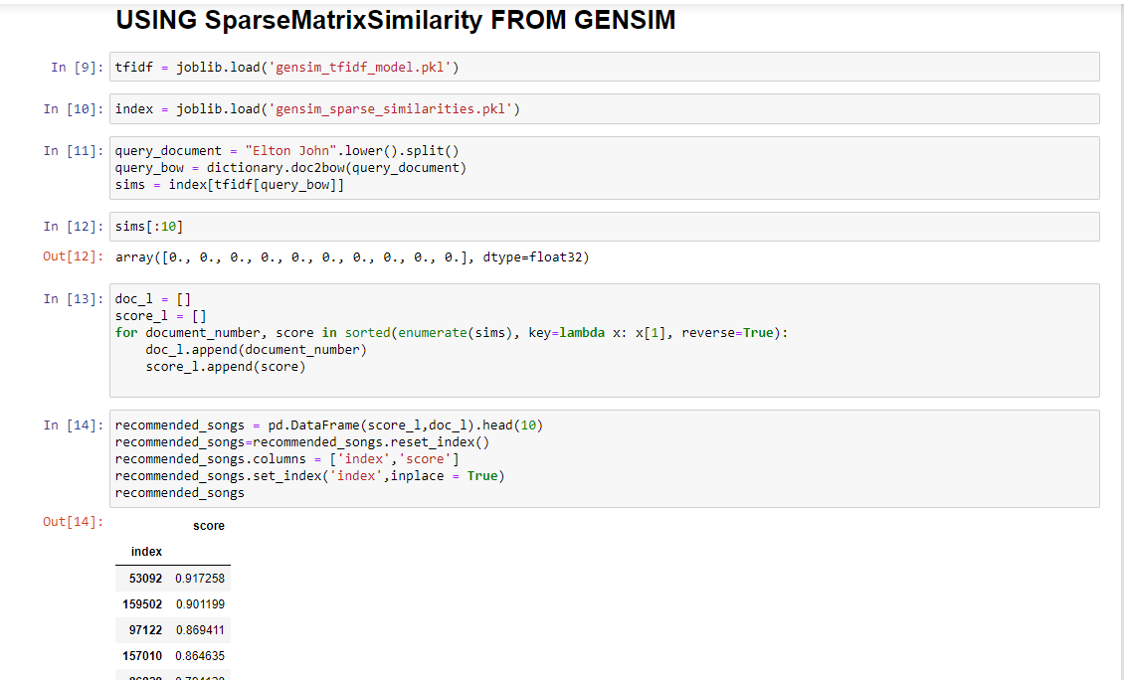
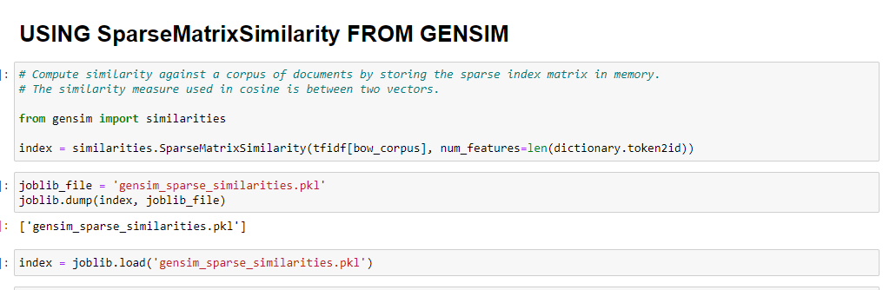
Logic – Content based Recommendation
Step 5 : Using tfidf from Gensim & train the model. Also saving gensim_tfidf_model.pkl
Step 7 – Loading Processed corpus from Pickle and using corpora dictionary
Step 6 : Using Sparse Matrix similarity from Gensim
Step 8 – Using Sparsity Matrix Similarity from Gensim & Assigning scores

Slide 7
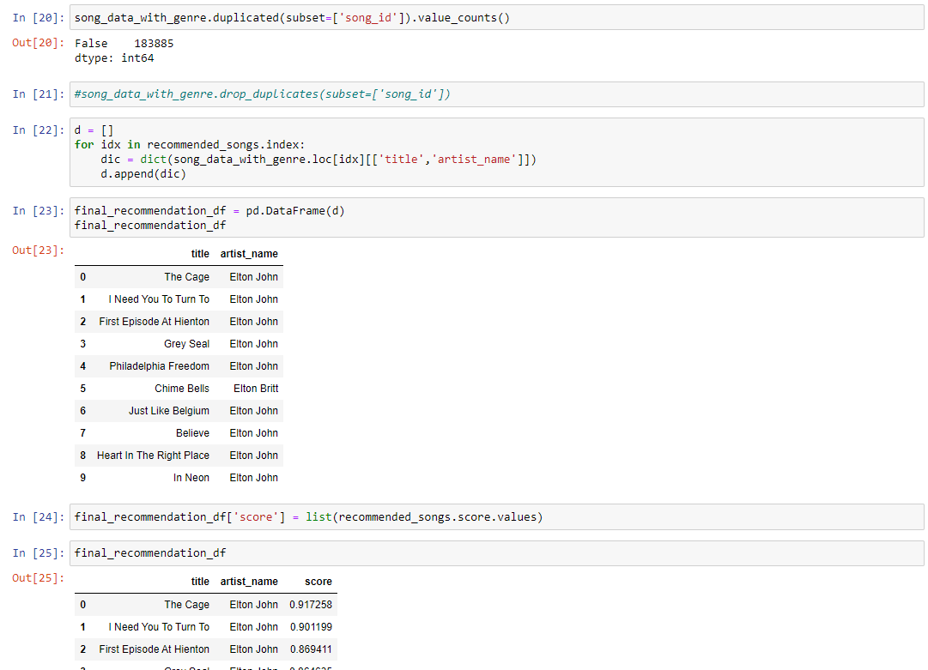
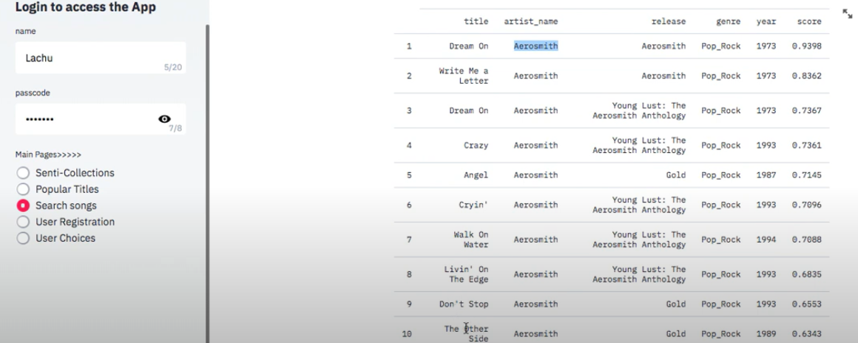
Logic – Content based Recommendation
Step 9 – Removing duplicates and creating final_recommendation_df to showcase the scores.

Slide 8
Music heals the soul
Capstone Project
Thanks

